Slide 1

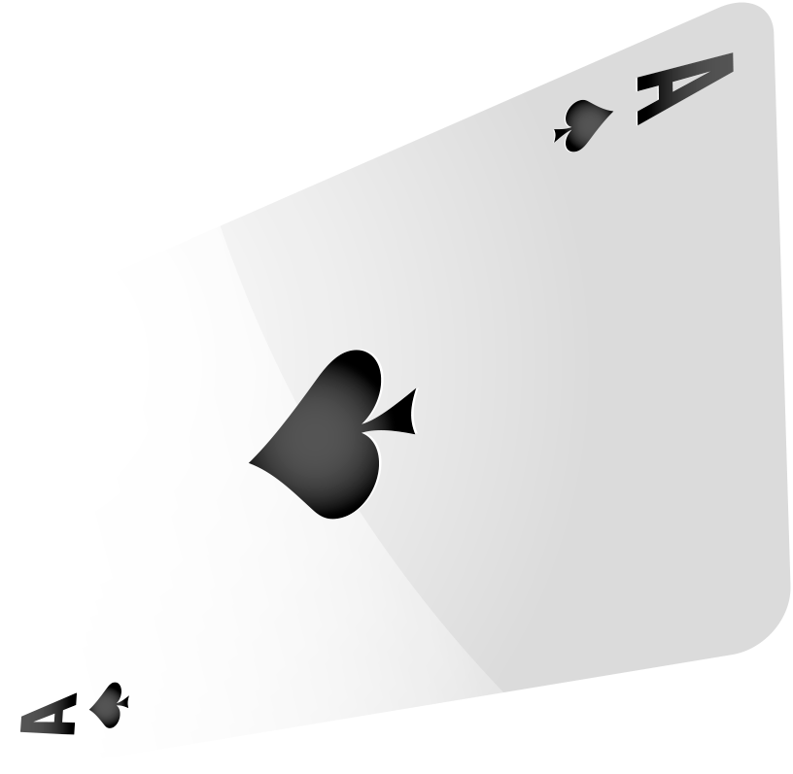

CASINO Number Guessing Game
Venna V Yuvan AP22110010679
Rajat Roy AP22110010673
Jeevan.K AP22110010672
Sneha AP22110010669
Varshitha AP221100106
Gayathri AP221100106

Slide 2
TABLE OF CONTENTS
1
ABSTRACT
2
INFORMATION
3
DFD
4
FLOWCHART
5
METHODOLOGY
An Outline for the whole project.
What exactly is the project about…
Data Flow Diagram
A Step-to-Step Arrangement
Process of the attaining the project

Slide 3
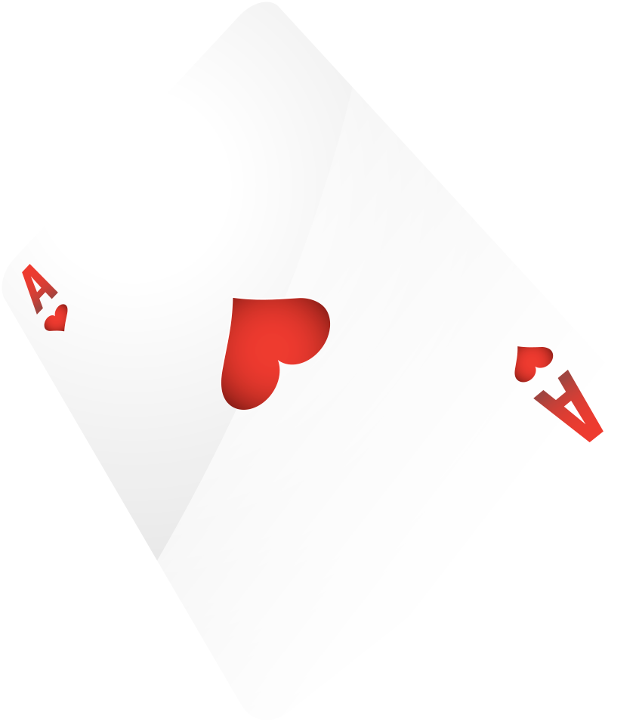
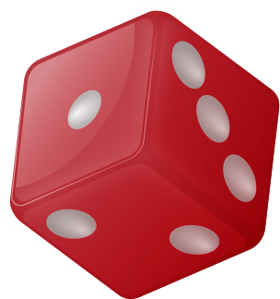
1
ABSTRACT

Slide 4
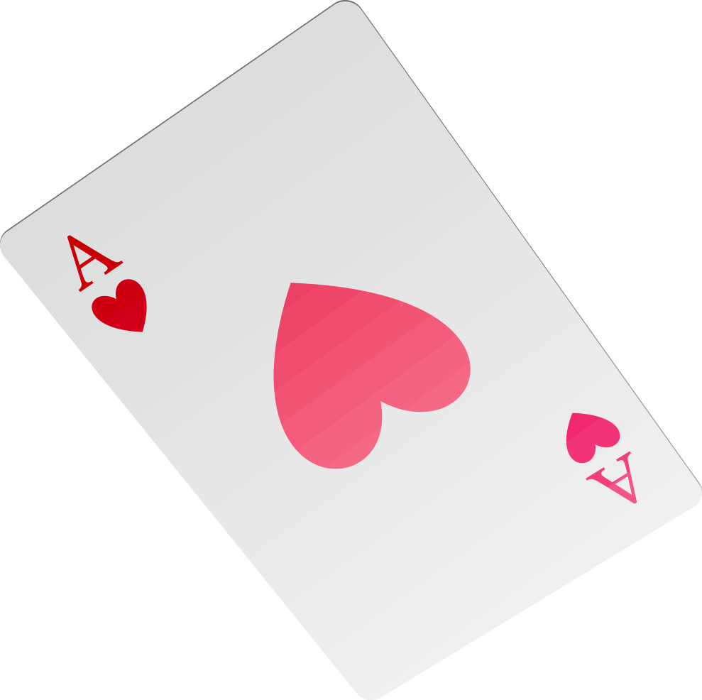


.
The "Number Guessing Game" project is a C++ application that provides an interactive and entertaining experience for users by challenging them to guess a randomly generated number within a specified range. The game offers a user-friendly command-line interface and allows players to set the difficulty level, such as the range of numbers to guess from. The project leverages fundamental programming concepts like conditional statements, loops, and random number generation.

Slide 5
Key features of the "Number Guessing Game" project include: User-Friendly Interface: The game presents a clear and concise command-line interface that guides the user through the game, making it easy to understand and play. Random Number Generation: The project utilizes the C++ standard library to generate a random number within the chosen range, ensuring a different experience in each game session. Difficulty Levels: Players can select from different difficulty levels by specifying the range of numbers to guess from, making the game suitable for users of all ages and skill levels. Feedback and Scoring: The game provides feedback to the player after each guess, indicating whether the guess is too high or too low. It also keeps track of the number of attempts and calculates a score based on the player's performance. Replayability: After each game, players have the option to replay the game with the same or different settings, encouraging repeated engagement. This project not only offers entertainment but also serves as a practical demonstration of core C++ programming concepts. It can be extended and customized to include additional features and challenges, making it an excellent learning resource and a fun pastime for users.

Slide 6
2
INFORMATION

Slide 7
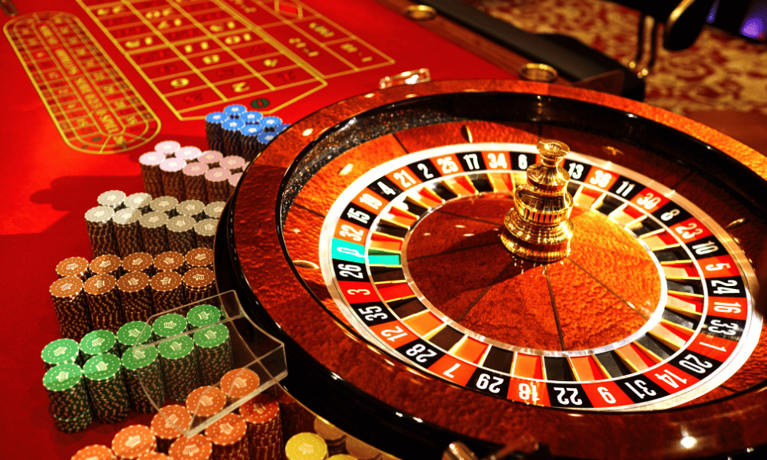
Casino is also the name of a card game. The word comes from the Italian casa, or "house." In the 1800s casino came to mean "building for aristocratic gambling. What does term casino mean? The term casino may mean a small country villa, summerhouse, or social. Functions to learn:- The srand() function sets the starting point for producing a series of pseudo-random integers. If srand() is not called, the rand() seed is set as if srand(1) were called at program start. Any other value for seed sets the generator to a different starting point. Getline() is an in-built function defined in the <string. h> header file that allows accepting and reading single and multiple line strings from the input stream.

Slide 8
3
Data Flow Diagram
.

Slide 9
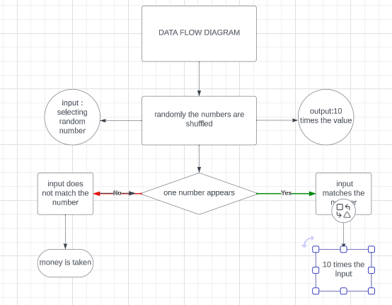

Slide 10
4
Flowchart

Slide 11
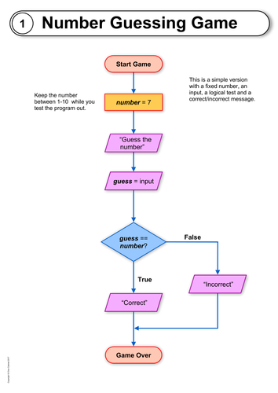

Slide 12
5
Methodology

Slide 13
1. Game Concept and Rules: Define the concept of the number guessing game. Decide on the game's objectives, rules, and any variations you want to include. Determine whether there will be a unique winning number or if it will change with each round. 2. Software and Hardware Setup: The hardware required to run the game, random number generators, and player terminals. 3. Random Number Generation: Implementation of a secure and fair random number generation system. This is crucial to ensure that the game is not biased or rigged. 4. Player Accounts: Storing player details for their games, which includes its name and the amount of money that is present in the account. 5. Betting Mechanism: Creating a system for players to place bets using virtual or real currency, depending on the casino's policies. Defining the payout structure for correct guesse.

Slide 14
6. Game Interface: Designing an intuitive and user-friendly game interface that allows players to input their guesses and place bets. Including features like a display of the winning number, and a history of previous rounds. 7. Game Logic: Implement the core game logic, including the generation of the winning number for each round. Determine the algorithm for calculating payouts based on the player's bet and the correctness of their guess. 8. Player Support: Providing customer support for players who have questions, encounter issues, or need assistance with the game. 9. Responsible Gameplay: Promote responsible gaming by providing resources and information on gaming addiction and setting limits for players.

Slide 15
Thank you

